Slide 1

Veterinary Entrepreneurship Academy: my Summer Internship Project and experience
by: Brittney LaDue

Slide 2

Why did I apply to be in the VEA?
I wanted to expand my knowledge of business and entrepreneurship
I want to start my own veterinary business someday
I wanted to try something new
I want to have diverse and unique experiences within the veterinary profession
Additional benefits:
  Looks good on your resume
  You meet really cool people
  You expand your network
  You get job offers
  You get to travel

Slide 3

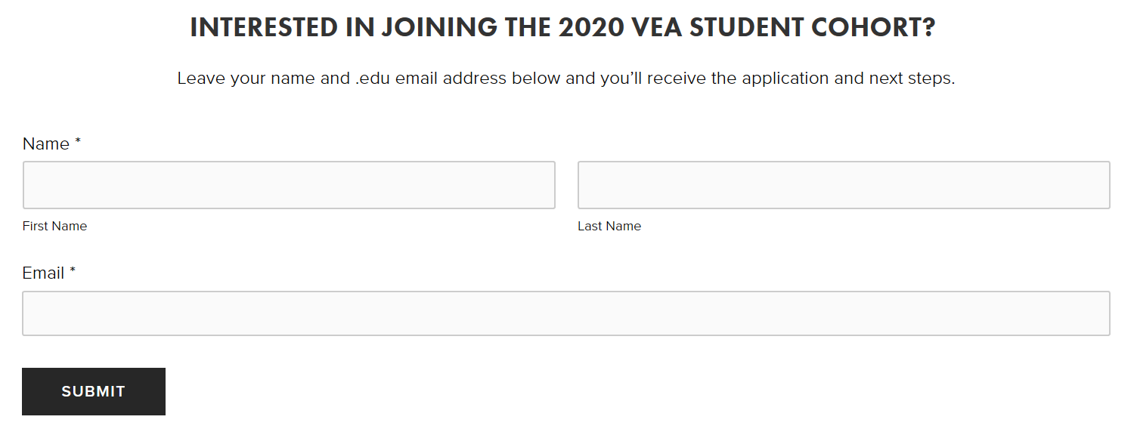
How do you apply?
www.vea.vet – fill out steps for the application process
Phone interview with Dr. Trimble
Phone interviews with potential companies
Get matched with a company based on what both parties think is the best fit

Slide 4






What companies can you be matched with?
Start up companies
Well established companies with a new idea
All are innovative companies that are willing to work with vet students to come up with solutions to problems that are faced in the veterinary profession
Just a few of the companies that VEA students worked with last summer

Slide 5


Where did I go and what did I do?
Veterinary Village and International Canine Semen Bank WI/IL in Lomira, Wisconsin
  Small Animal Private Practice and Canine Semen Storage Facility
    Specializing in Canine Reproductive Services
    Dr. Marty Greer and staff
My Summer Project: Design a website that would serve as a database for dog breeders wishing to advertise the availability of their stud dog’s frozen semen, similar to a bull sale catalog. This promotes a preservation culture in the world of purebred dogs and a way to connect dog breeders, dog owners, and veterinarians.

Slide 6
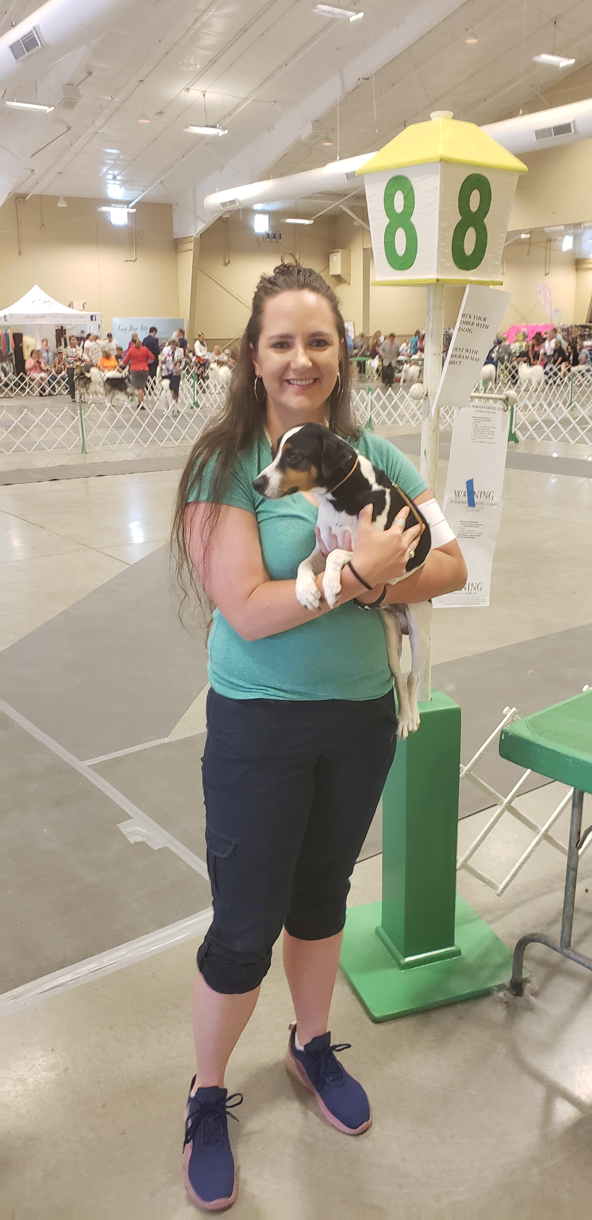
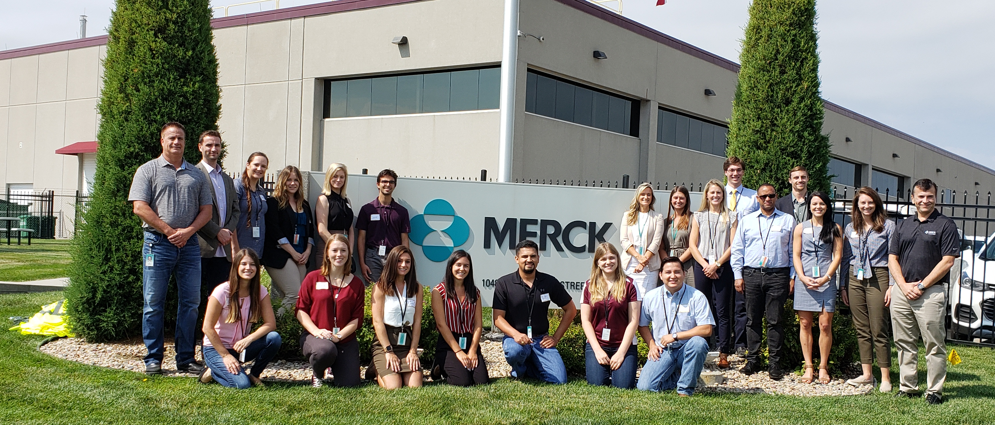
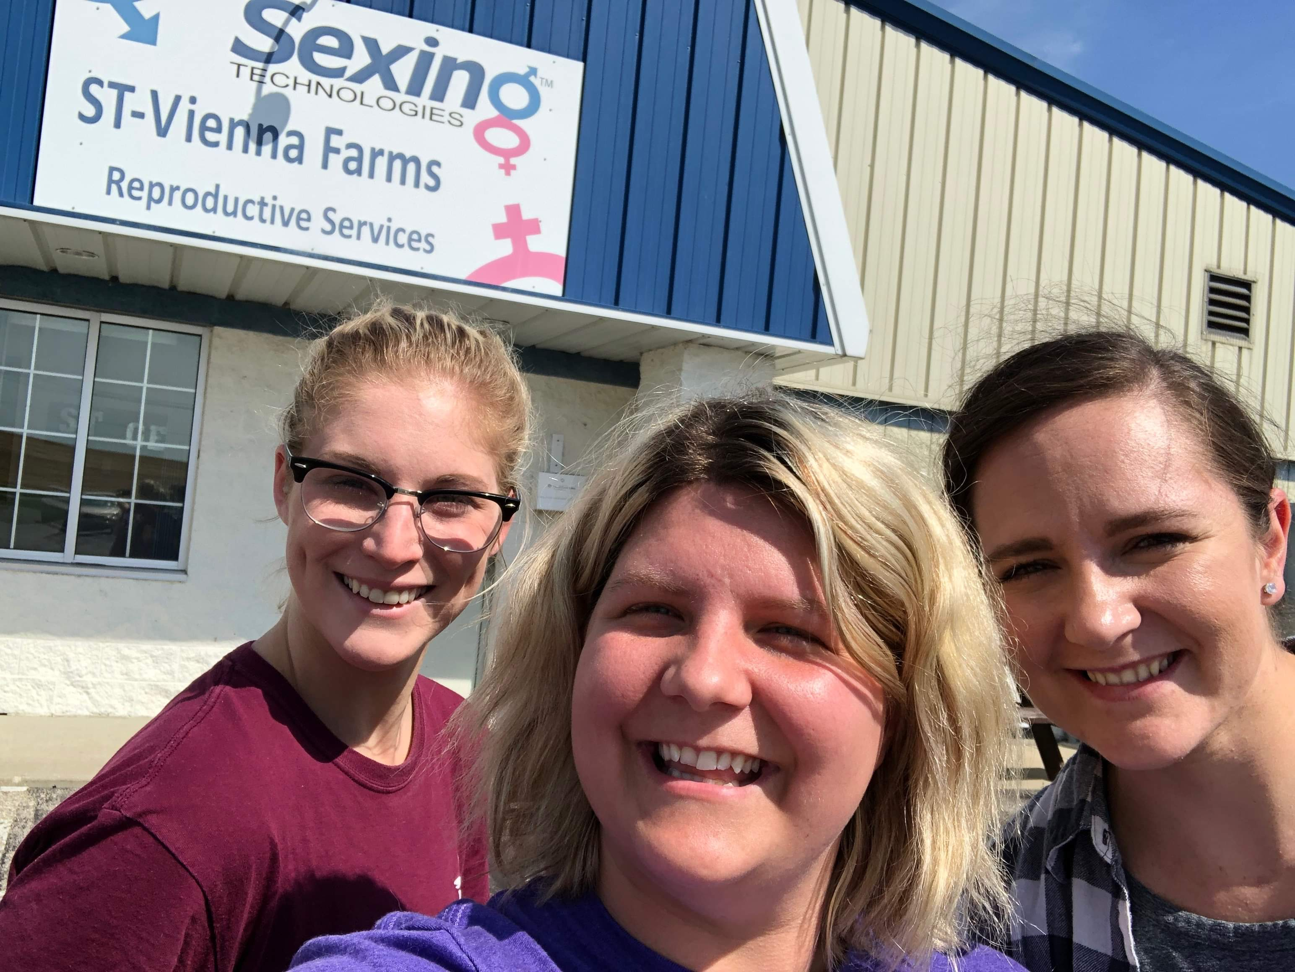
What did I do (continued)…
Shadowed Dr. Greer in her clinic to get hands on medical experience
  I got to scrub in on 2 c-sections and pulled out 5 puppies!
Attended the Society for Theriogenology Conference in Savannah, Georgia
Toured Sexing Technologies in WI – a facility where bovine semen is sexed
Attended several local dog shows and I even showed a dog in the ring (I was terrified!)
Toured Merck Animal Health facility in Omaha, Nebraska with fellow VEA students

Slide 7

Fundamentals of Entrepreneurship Webinar Course
Throughout the 10 weeks of the internship, VEA students attend two online class sessions per week with Dr. Rob, fellow VEA classmates, and guest lecturers.
These courses teach strategies and the building blocks to start a business.
I was able to apply what I learned in the courses to the project I was working on.
My Top 3 Takeaways…

Slide 8

1. Get comfortable with being uncomfortable
There will always be unknowns and failures along the way.
Your imposter syndrome will tell you that you can’t, but tell yourself that you can.
Reach out to potential customers and ask them what they need/what problem can you help them solve.
Changes in our profession are happening rapidly so we need to change with it.
  We have choice to change – doing nothing is still a choice.
Ask the dumb questions now.
Get creative!

Slide 9

2. Tell your story
Connect with your customer – sell YOU. If people don’t believe you, they won’t believe in what you are selling either.
Ensure your product or service is bringing value to and solving a problem for your customer.
Sell the solution, not just the product.
Don’t try to please everyone – just do a few things really well.

Slide 10


3. Surround yourself with a reliable team and partners
As an entrepreneur, you will be wearing multiple hats, but…
We are like swiss cheese – we all have gaps in our knowledge base.
  Fill these large gaps with people who have expertise in an area that you don’t.
Find people that you can make decisions with TOGETHER.

Slide 11

Overall, the VEA…
Is fun!
Is engaging
Helps instill confidence
Immerses you into real life situations
Helps you learn to problem solve
And so much more!

Slide 12

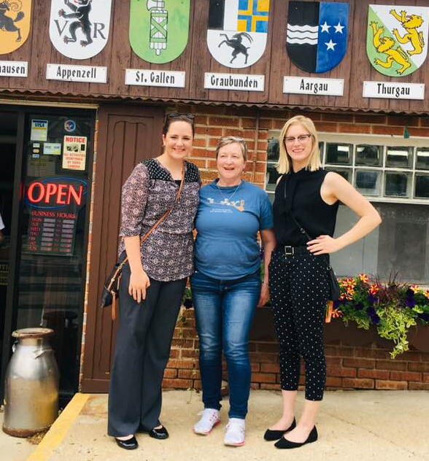
More information:
VEA’s website: www.vea.vet
Please email me: ladue016@umn.edu

